Slide 1
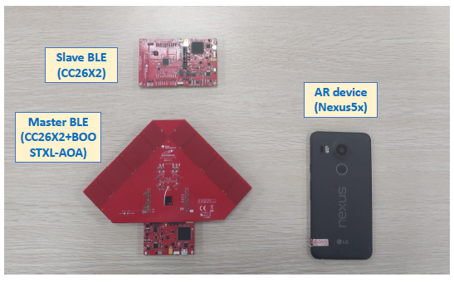
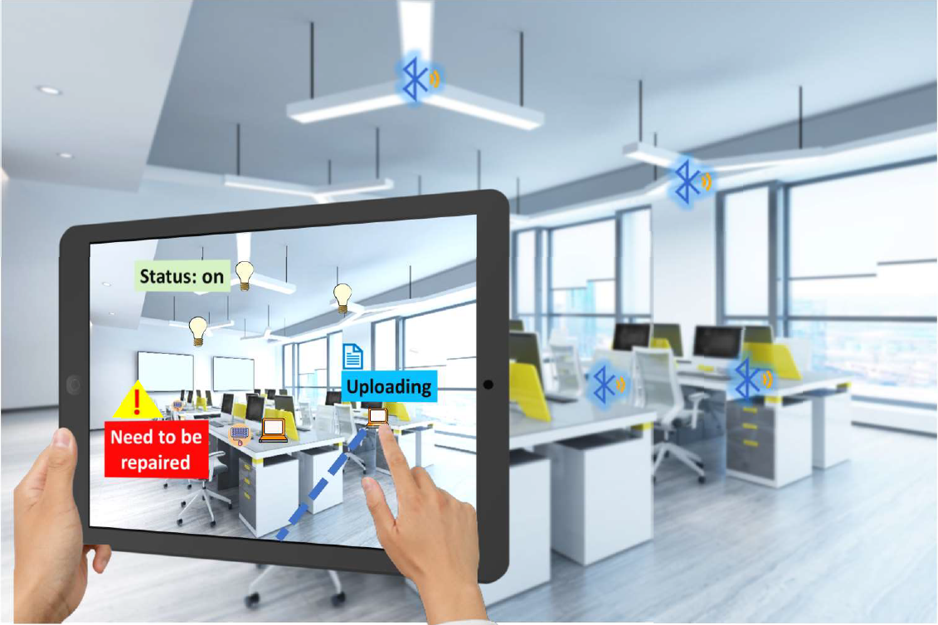
VisBLE
BLE TAG IDENTIFICATION WITH VISION ENHANCEMENT

Slide 2
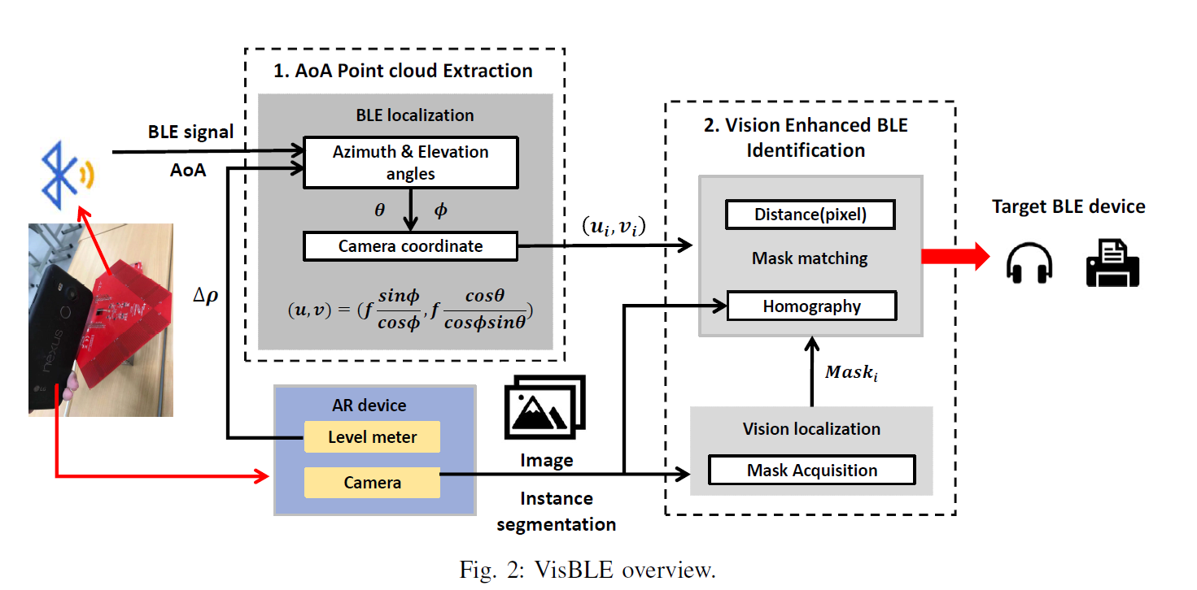

Slide 3
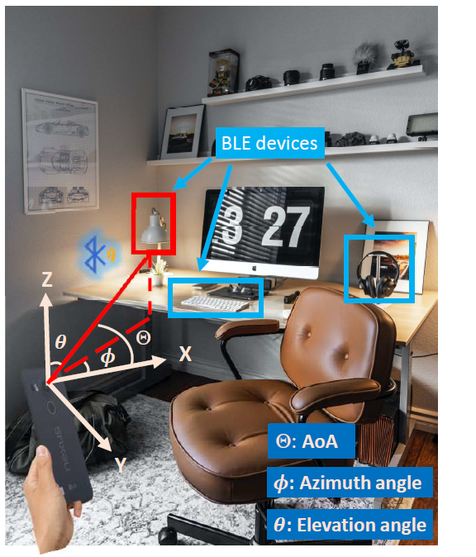

Slide 4
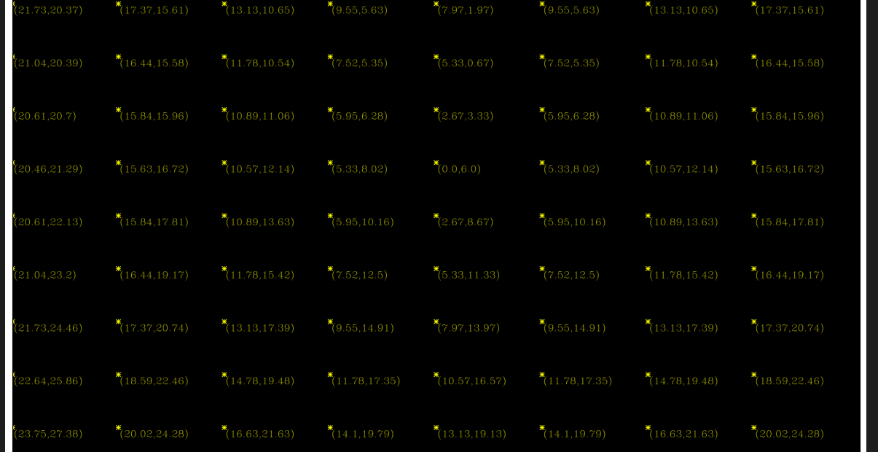
Reverse Inspection
By fixing the change in level meter angle, calculating the expected values for angle of arrival before and after turn.
Value 1: Expectation for angle of arrival value before the turn
Value 2: Expectation for angle of arrival after turning the camera

Slide 5
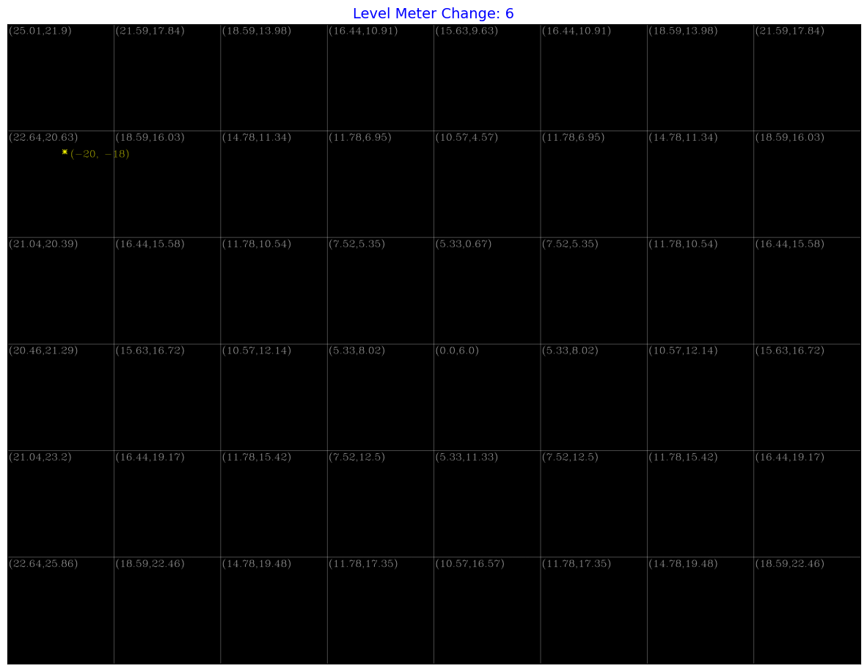
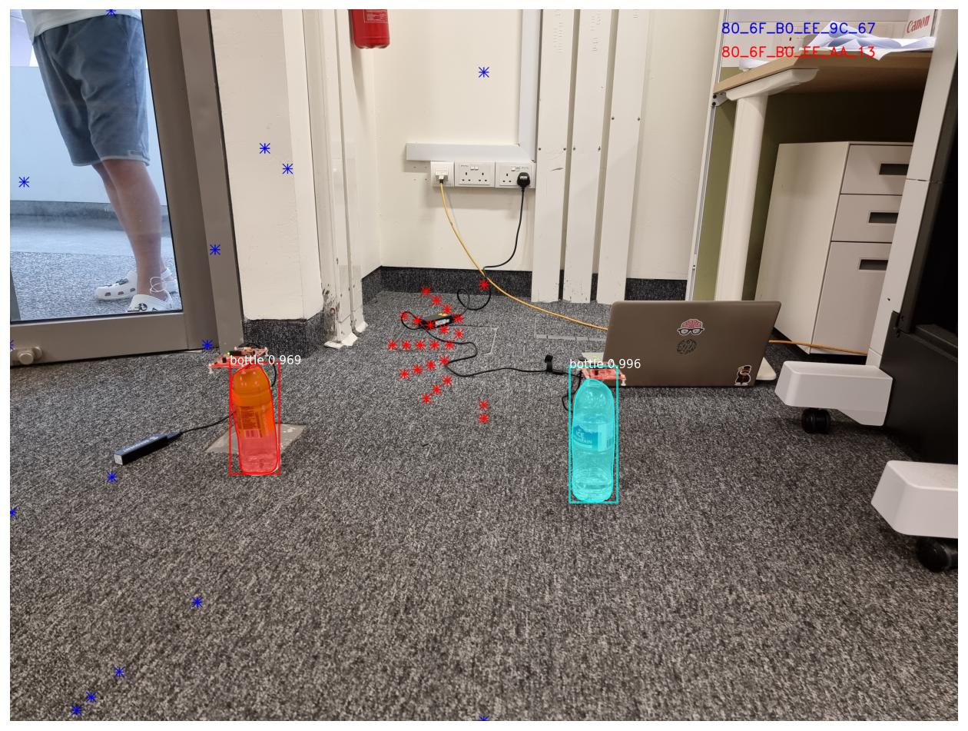
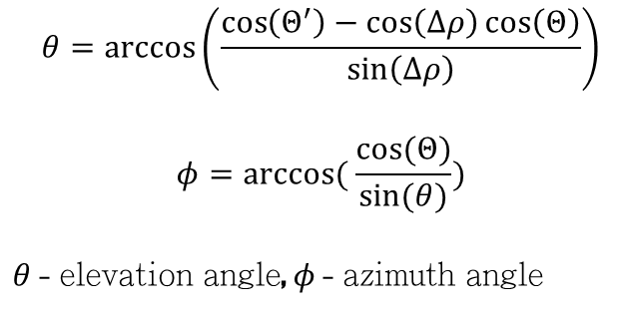
Azimuth Angle Ambiguity
$$θ=\arccos\left(\frac{\cos\left(Θ^{′}\right)−\cos\left(Δρ\right)\cos\left(Θ\right)}{\sin\left(Δρ\right)}\right)$$
$$φ=arccos⁡( \frac{cos⁡(Θ)}{sin⁡(θ)})$$
$θ$ - elevation angle, $φ$ - azimuth angle

Slide 6
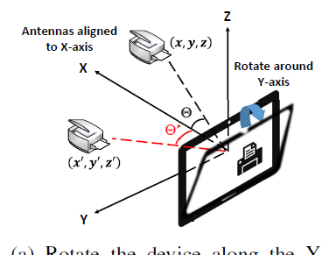
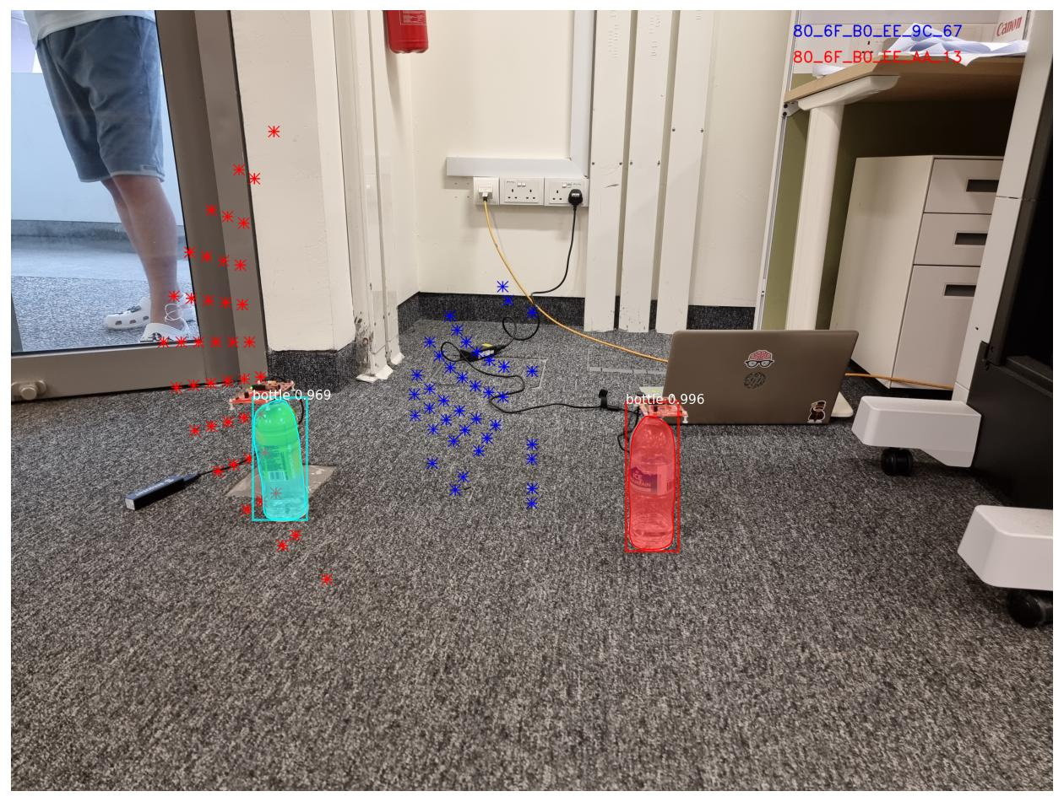
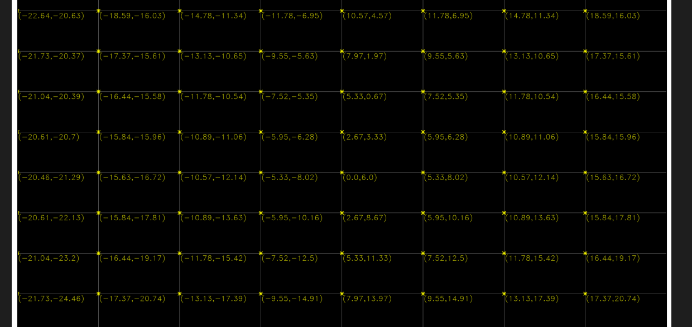
Solution:
Making azimuth as negative for positive values of angle of arrival.

Slide 7
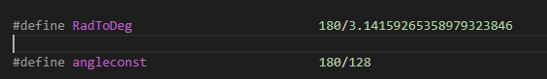
Angle Resolution Issue
Extract from aoa.c – Angle of Arrival Calculation Ti Board
Only 8 bits are used for angle calculation. So the result cannot be accurate more than 360/256 > 1
This imposes restrictions on possible point spread.
LET US ANALYZE THEM…!

Slide 8
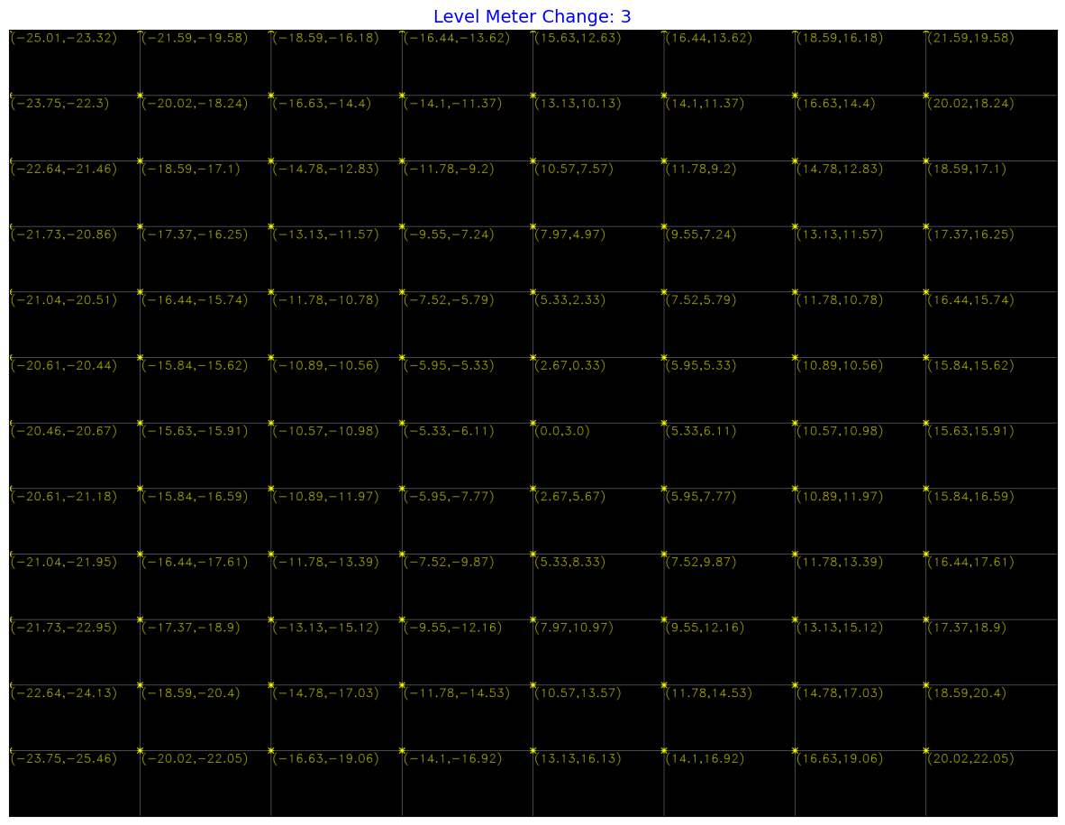
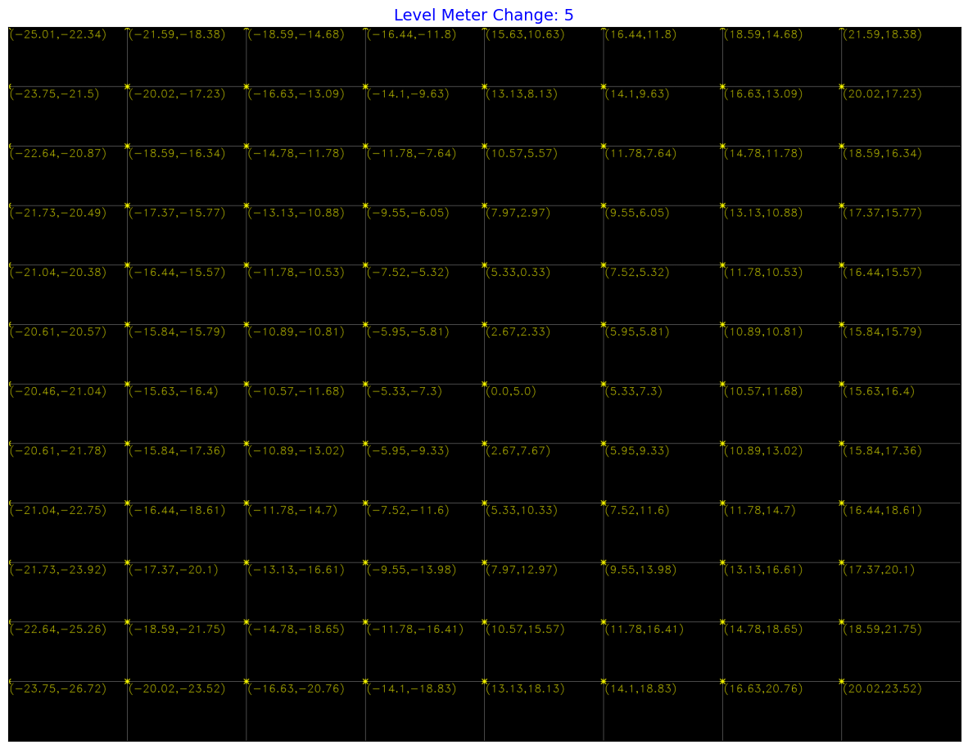
Expected Values for Angle of Arrival for Small Level Meter Change

Slide 9
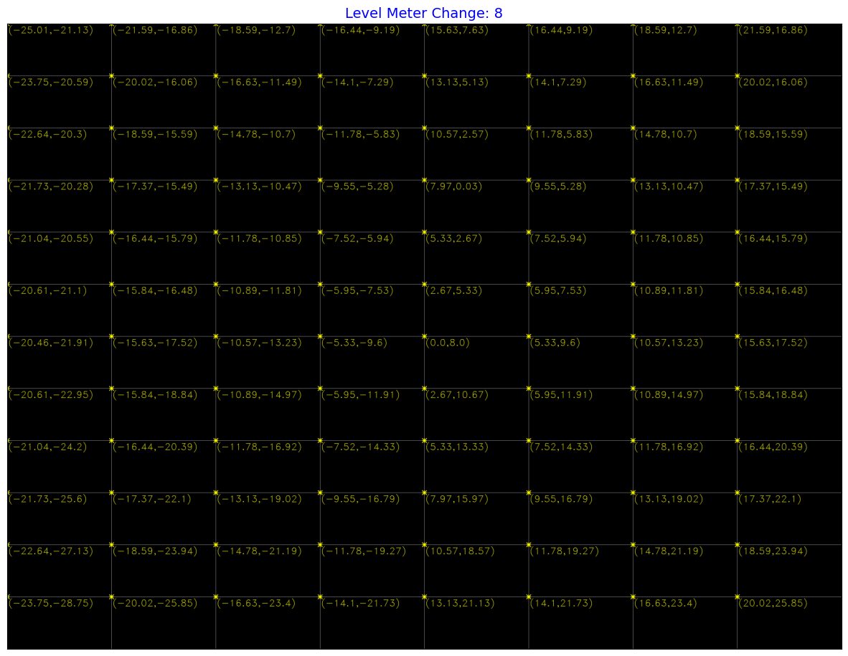
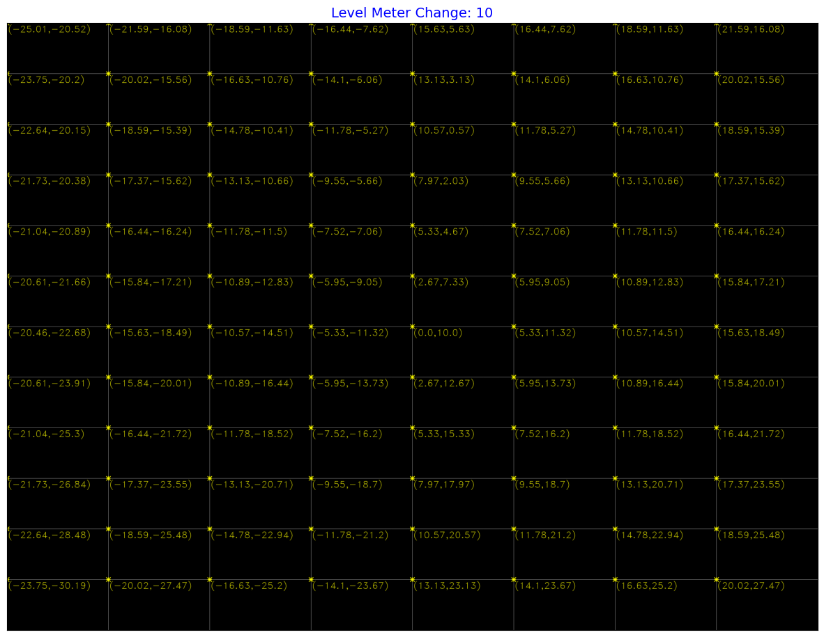
Expected Values for Angle of Arrival for Large Level Meter Change

Slide 10
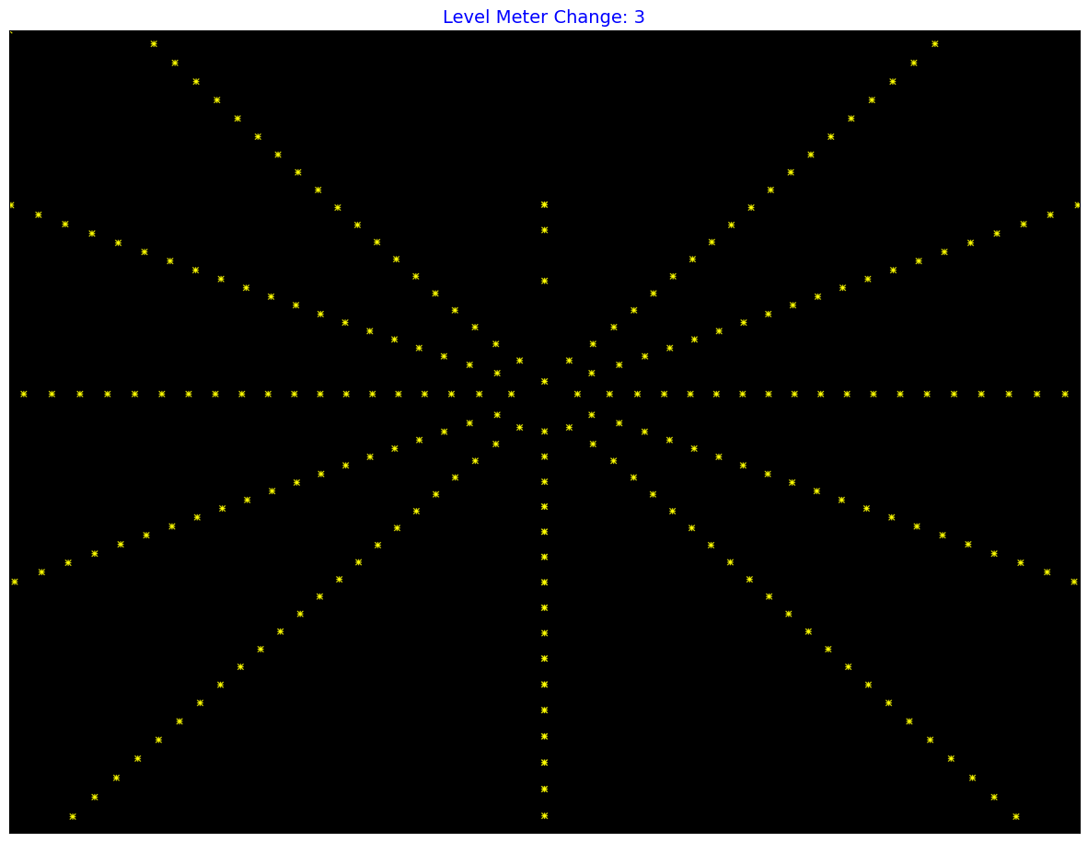
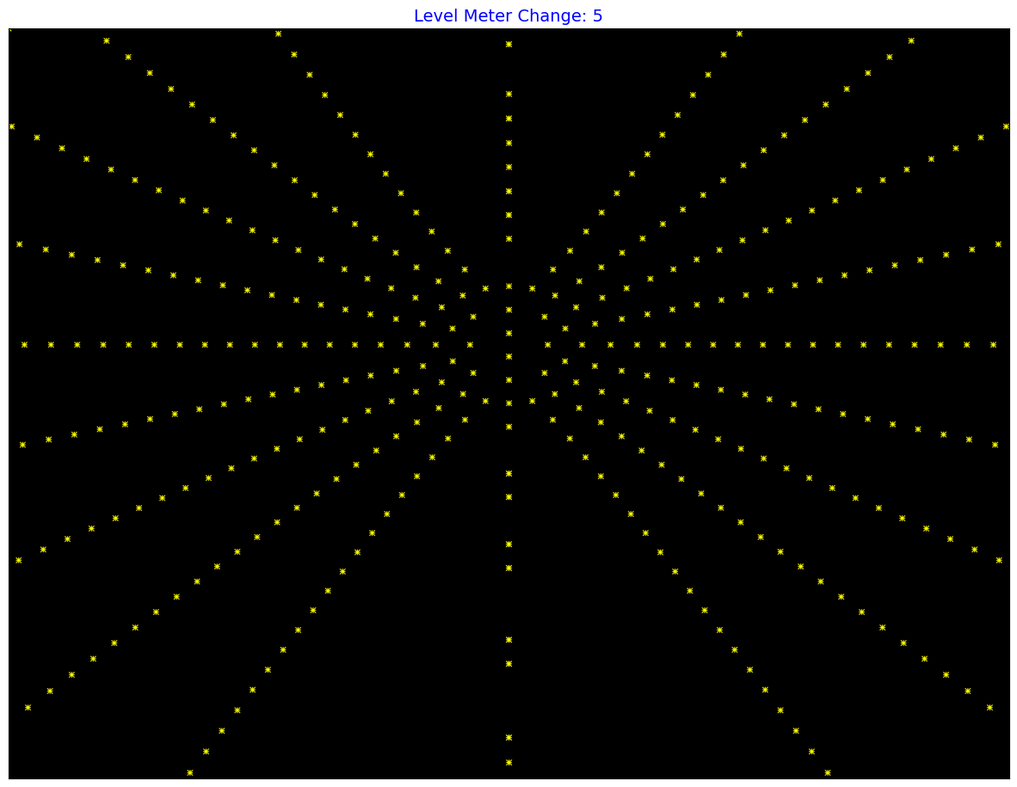
Point Location Possible on the Assumption of AoA Accuracy $±1$
Range: -30 -> 30

Slide 11
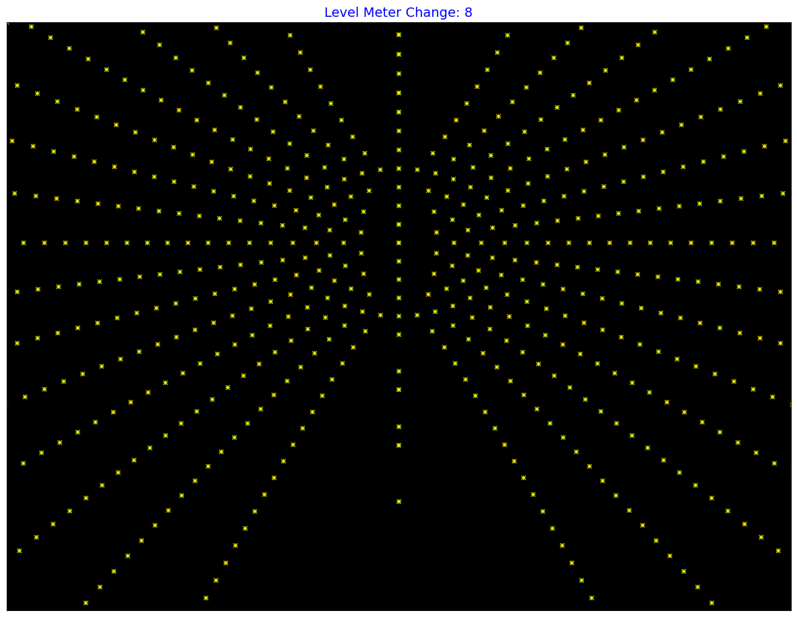
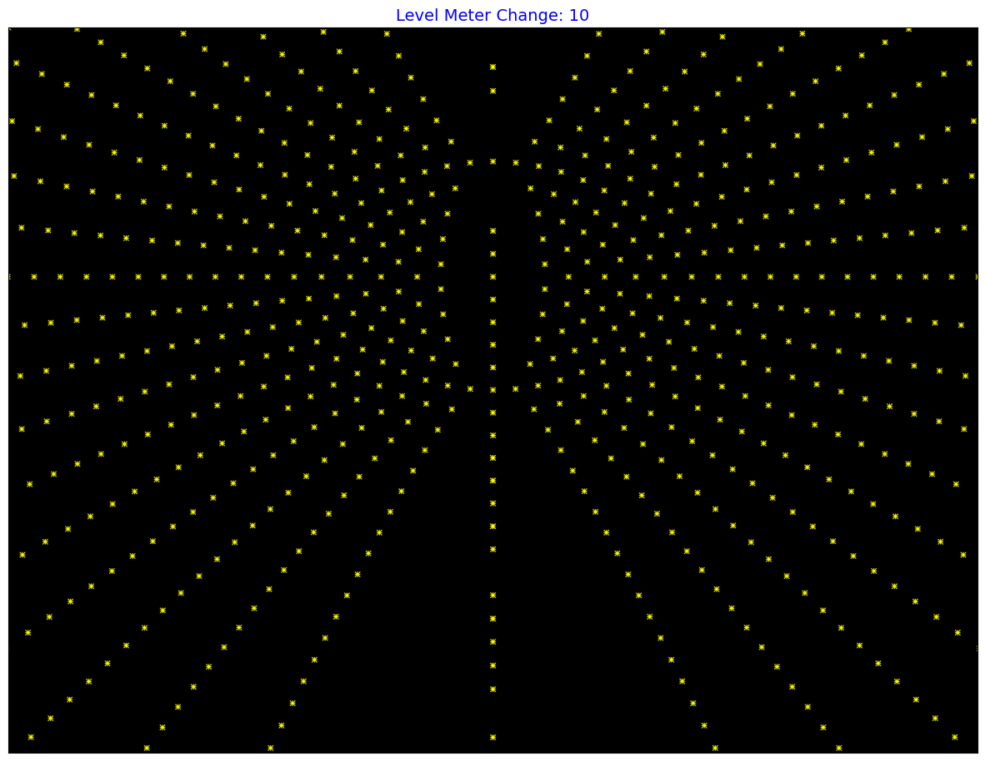
Point Location Possible on the Assumption of AoA Accuracy $±1$

Slide 12
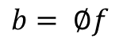
Compressed Sensing
Representation based on Some Basis :
Measurement :
Problem :
$$f= φx (Choose basis to make x a sparse vector)$$
$$b= ∅f$$
$$sparsest solution satisfying Ax=b (Can be achieved by reducing {\left\|x\right\|}_{1})$$
Related Idea
Since we expect the data to be denser only in the locations of devices the points vector can be considered sparse in pixel domain.
Based on the accuracy limitation it is visible that we can only identify the points according to a very low resolution grid.
Possible Problem Formation
If we can measure a low resolution grid data for possible locations. Can we use this to recreate a more accurate pixel location?

Slide 13
Algorithm Proposal
Divide the image into a low resolution grid.
Apply the voting scheme: For each pair of possible angle of arrival we calculate the relevant pixel and vote for the relevant section in the low resolution image.
Based on the votes we allocate the area for corresponding slave by giving priority to the slave with maximum vote.
Two possibilities
Allocating only one section to a slave.
Allocating all possible sections
Help to handle the overlapping problem of pixels.
Later we can use the compressed sensing for the recreation of more accurate location.

